Slide 1
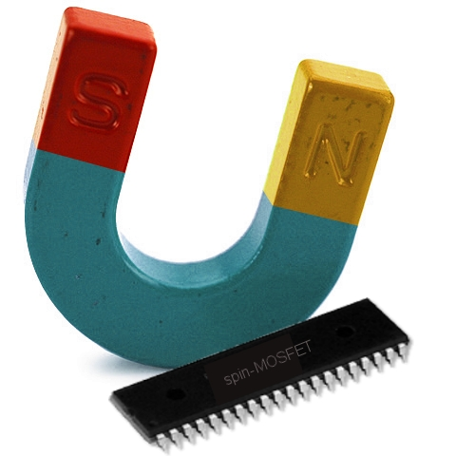

Silicon spintronics
Ron Jansen
S. Sharma, A. Spiesser,
K. R. Jeon, S. Iba,
H. Saito, S. Yuasa.
National Institute of Advanced Industrial Science and Technology (AIST)
Spintronics Research Center
Tsukuba, Japan
In collaboration with:
S.P. Dash, Chalmers University of Technology, Göteborg, Sweden
J.C. Le Breton, FOM, Utrecht, The Netherlands
A.M. Deac, Helmholtz-Zentrum Dresden-Rossendorf, Dresden, Germany
B.C. Min, KIST, Seoul, Korea
S.C. Shin, KAIST, Daejeon and DGIST, Daegu, Korea
B.J. van Wees, University of Groningen, Groningen, The Netherlands

Slide 2

IEEE Magnetics Society Home Page: www.ieeemagnetics.org
  3000 full members
  300 student members
The Society
  Conference organization (INTERMAG, MMM, TMRC, etc.)
  Student support for conferences
  Large conference discounts for members
  Graduate Student Summer Schools
  Local chapter activities
  Distinguished lecturers
IEEE Transactions on Magnetics
IEEE Magnetics Letters
Online applications for IEEE membership: www.ieee.org/join
  360,000 members
  IEEE student membership / IEEE full membership

Slide 3
Charge
Thermoelectrics
Spintronics
Heat
Spin
Spin-caloritronics

Slide 4
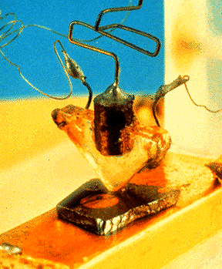
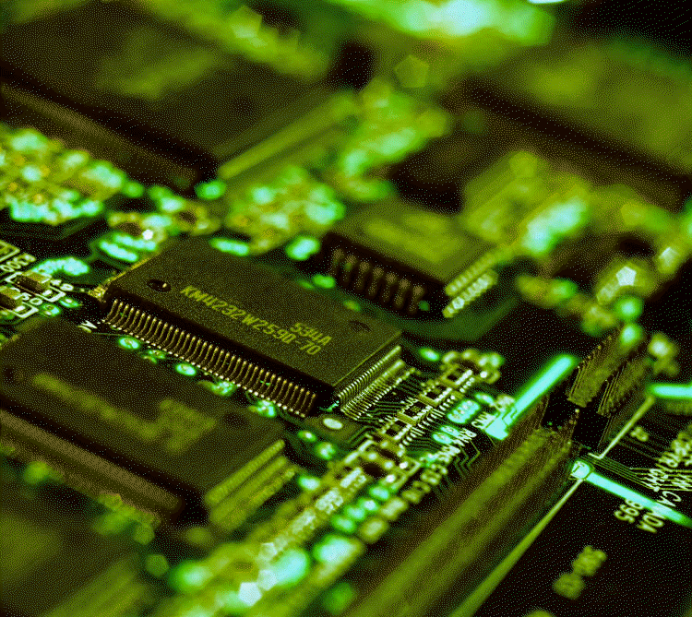
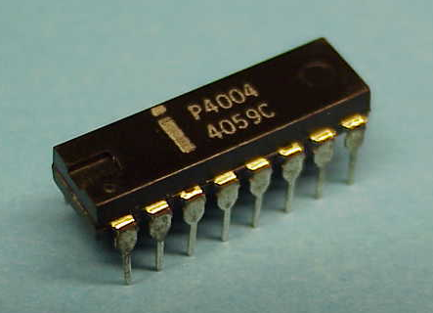
Issues in computing based on charge
Concerns about continuation of scaling down
Heat generated by electronic components limits performance
Computing is increasing fraction of world’s energy consumption
⇒ Need for alternative, low power solutions

Slide 5
Semiconductor Spintronics
a new technology based on spin
Semiconductors
Bandgap engineering - Carrier density & type -
Electrical gating -
Long spin lifetime -
Technology base - (electronics)
Ferromagnets
Non-volatile memory
Fast switching
High ordering temp.
Spin transport
Technology base (magnetic recording)
Combining the best of both worlds

Slide 6
Computer hierarchy & spin
Present state
Logic
Volatile
Data processing
Semiconductors
Register
L1 cache
L2 cache(SRAM)
L3 cache (SRAM)
Main memory (DRAM)
Non-volatile
Data storage
Ferromagnets
Storage (HDD, SSD)
Courtesy of K. Ando

Slide 7
Computer hierarchy & spin
Present state
Target
Semiconductor spintronics
Logic
Volatile
Spin-FET, Spin Logic
Data processing
Semiconductors
Register
L1 cache
L2 cache(SRAM)
Metal-based spintronics
L3 cache (SRAM)
High-speed STT-MRAM
Main memory (DRAM)
High-density STT-MRAM
Non-volatile
Ultrahigh-density HDD MgO-MTJ read head
Data storage
Ferromagnets
Storage (HDD, SSD)
Courtesy of K. Ando

Slide 8
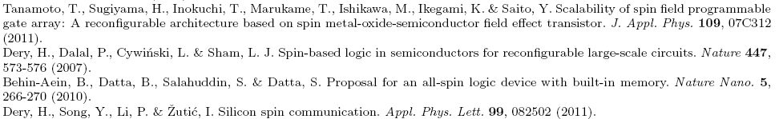
Proposed spin-based device and systems
Spin transistors
Spin diodes
Spin circuits and spin logic

Slide 9
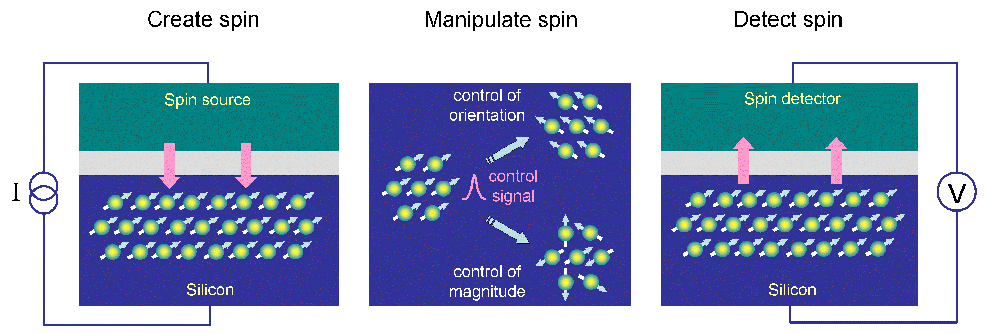
Building blocks of silicon spintronics
Create spin
Manipulate spin
0 ↔ 1
Detect spin
Magnetic field
Electric field
Ferromagnetic tunnel contact
Ferromagnetic tunnel contact

Slide 10
Topics
Electrical creation/detection of spin polarization in Si
Creating spin polarization in silicon by heat
Combining electrical and thermal spin currents
&
Voltage tuning of thermal spin currents

Slide 11
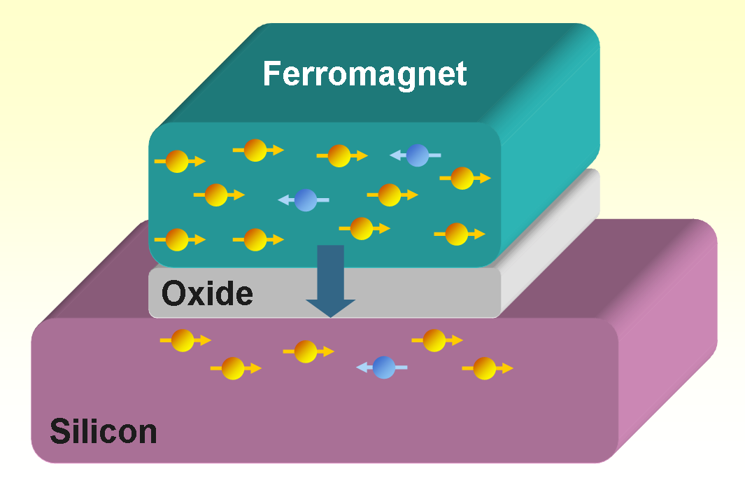
Creation of spin polarization in semiconductors
by electrical injection from a ferromagnetic tunnel contact
Transfer of spins by spin-polarized tunneling Creates spin accumulation
I_{T}↑ ≠ I_{T}↓
Δμ = μ↑ − μ↓
E
Δμ
Supply of spins by current
Spin relaxation in semiconductor
Δμ
n↑ > n↓

Slide 12
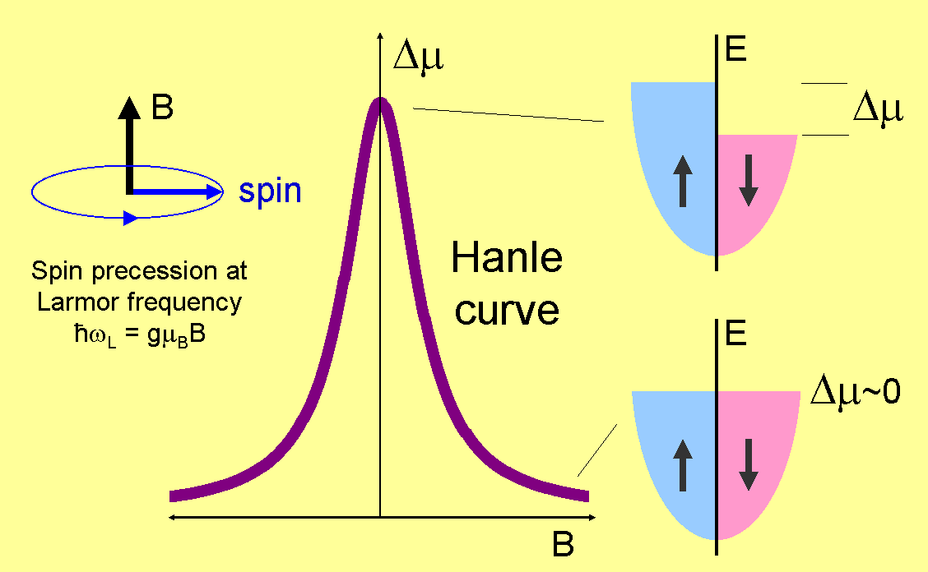
Spin manipulation & detection
Precession of spins in transverse magnetic field (Hanle effect)

Slide 13
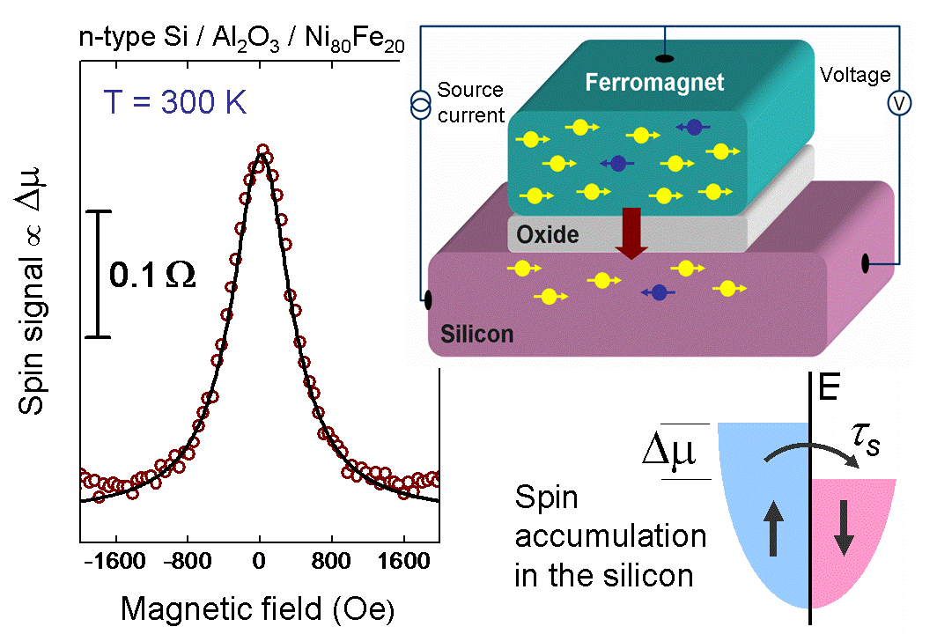
Creating spin polarization in silicon at 300 K
by electrical spin injection from a magnetic tunnel contact
S.P. Dash et al. Nature 462, 491 (2009)

Slide 14
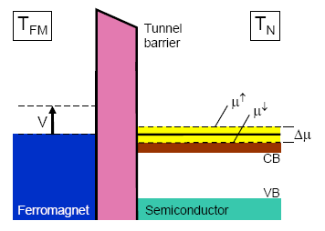
Electrical detection of spin polarization
Resistance of tunnel contact is proportional to Δμ
G↑ − G↓
Tunnel spin polarization:
P =
G↑ + G↓

Slide 15
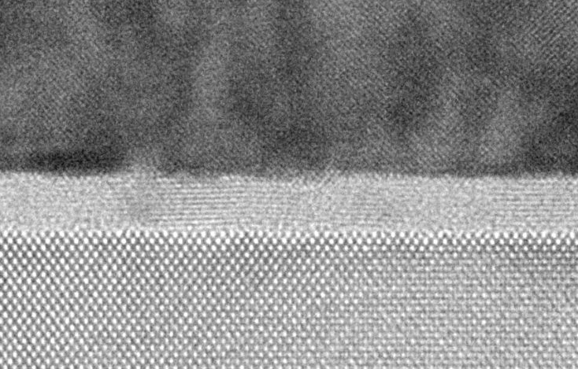
Creation of spin polarization in silicon at 300 K
Crystalline Fe / MgO tunnel contact
p-type Si (Boron, p = 5 x 10¹⁸ cm⁻³)
Fe
MgO
0.5 - 2 nm
S. Sharma et al.
PRB 89, 075301 (2014)
A. Spiesser et al.
Proc. SPIE 8461,
84610K (2012)
Silicon

Slide 16
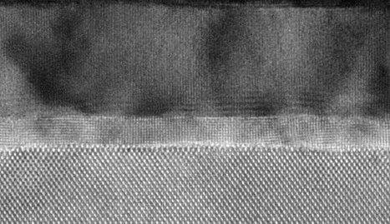
Spintronics with p-type germanium at 300 K
Crystalline and Schottky free contacts
S. Iba et al., APEX 5, 053004 (2012)
Fe
MgO
Germanium

Slide 17
Control experiment with Yb or Au nanolayer
Standard
Silicon / Al₂O₃ / Ni₈₀Fe₂₀
P = 30%
Control device
Silicon / Al₂O₃ / Yb (2 nm) / Ni₈₀Fe₂₀
P = 0
Standard
Silicon / Al₂O₃ / Ni₈₀Fe₂₀
P = 30%
Control device
Silicon / Al₂O₃ / Au (3 nm) / Ni₈₀Fe₂₀
P = 0
Proof that signal is due to spin injection by tunneling

Slide 18
Electrical creation of spin polarization in silicon
Spin lifetime and spin precession
near a tunnel interface

Slide 19
Spin lifetime in n-type silicon - Hanle vs. ESR
See reviews on Silicon Spintronics:
R. Jansen,
Nature Materials
11, 400 (2012)
R. Jansen et al.
Semicon. Sci.
Technol.
27, 083001 (2012)

Slide 20
Extrinsic contributions to spin relaxation
spin precession in local magnetostatic fields
Inhomogeneous spin precession axis and frequency

Slide 21
Spin relaxation near magnetic tunnel interface
role of ferromagnetic electrode
Injected spins feel
presence of the
ferromagnet !
⇒ Apparent reduction
of spin lifetime
Ni₈₀Fe₂₀ → μ₀M_{sat} = 0.9 T
Co → μ₀M_{sat} = 1.8 T
Fe → μ₀M_{sat} = 2.2 T
T = 300 K
p-Si = 4.8 ⋅10¹⁸ cm¯³ (B)

Slide 22
Hanle effect and inverted Hanle effect
S
B_{external}
B_{ms}
S
B_{ms}
Spin precession in B_{ms}
Δμ reduced at B_{external} = 0
B_{external} in-plane, parallel to magnetization and injected spins, reduces precession
⇒ recovery of Δμ

Slide 23
Hanle, inverted Hanle & anisotropy
p-type Si / Al₂O₃ / Fe
Inverted Hanle effect:
spin precession modified by
inhomogeneous magnetic fields
(roughness, nuclear spins)
Anisotropy
All characteristic
features of
spin precession and
spin accumulation

Slide 24
Magnitude and scaling of the spin signal

Slide 25

Magnitude of the spin accumulation
Expectation based on standard model for spin resistance
J_{s}
Δμ
Spin current:
Spin resistance:
Use Einstein relation:
r_{s} = ρ L_{sd}
in Ωm²
Resistivity spin-diffusion length

Slide 26
Magnitude of the spin accumulation
disagreement between experiment and theory
See reviews on Silicon Spintronics:
R. Jansen,
Nature Materials
11, 400 (2012)
R. Jansen et al.
Semicon. Sci.
Technol.
27, 083001 (2012)

Slide 27
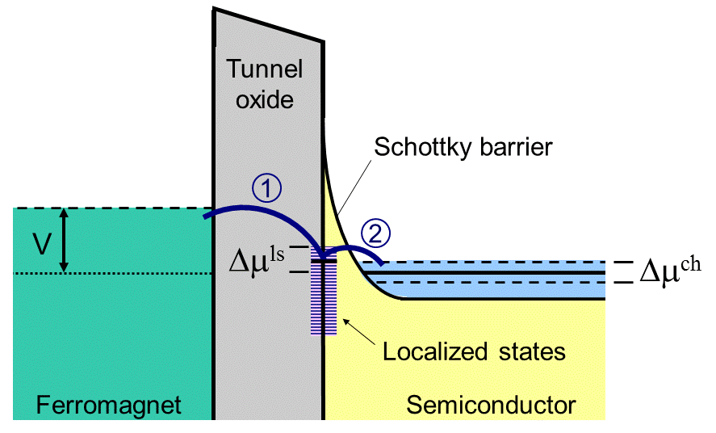
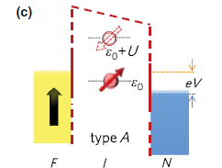
Theory proposals to explain the disagreement
Localized states in the oxide barrier or at the oxide/semiconductor interface
First proposal by Tran et al.
PRL 102, 036601 (2009)
Recent extension by Song and Dery
PRL 113, 047205 (2014)
- Two-step tunneling
- spin accumulation in localized states
- Hanle spin precession
- Same as Tran’s model, but
- added Coulomb repulsion energy U
- spin-dependent blocking for eV >> kT
But, experiments ………..

Slide 28
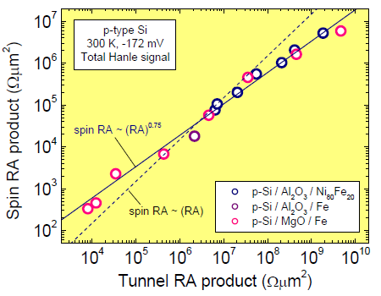
Magnitude and scaling of spin signal
Theory:
ΔV should be
proportional to J,
thus ΔV / J is a
constant
Experiment:
spin-RA = ΔV / J
scales with the
tunnel resistance
Not understood
S. Sharma et al.
PRB 89, 075301 (2014)

Slide 29
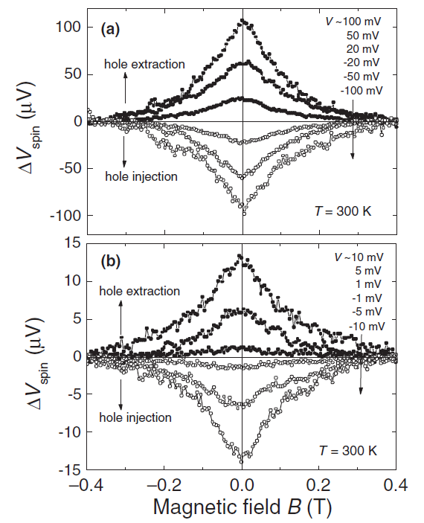
Magnitude of the spin signal for eV < kT
Ge / GeO₂ / Fe
No spin signal reduction in the regime eV < kT,
⇒ inconsistent with the theory of Song and Dery
Data from S. Spiesser et al,
Jap. J. Appl. Phys. 52, 04CM01 (2013)

Slide 30
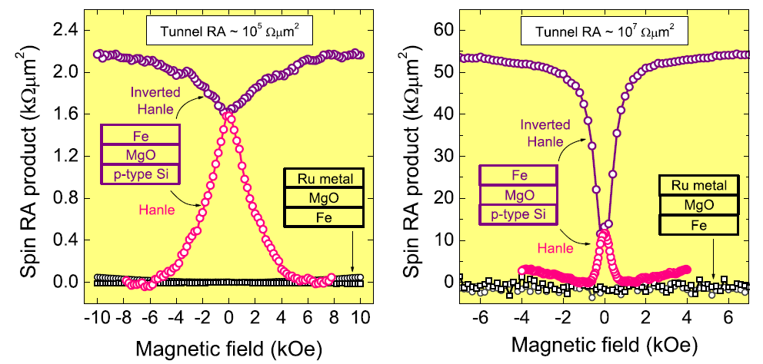
Control experiment with Ru metal instead of Si
S. Sharma et al. PRB 89, 075301 (2014)
Oxide but no semiconductor ⇒ no Hanle signal
Thus, signal does not originate from the tunnel oxide

Slide 31
Can we create spin polarization in silicon
by heat, instead of charge current ?

Slide 32
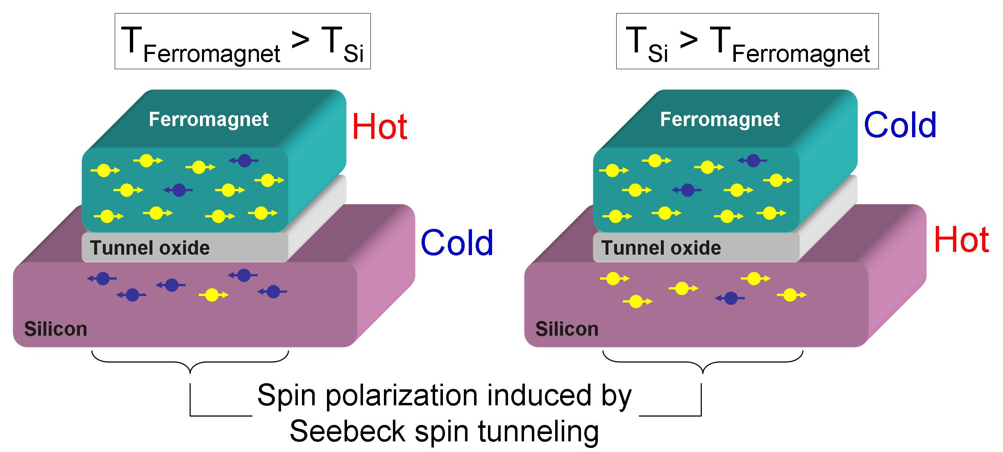
Thermal creation of spin polarization in Si
New phenomenon: Seebeck spin tunneling
Heat
flow
p.s. Zero charge
tunnel current !!

Slide 33
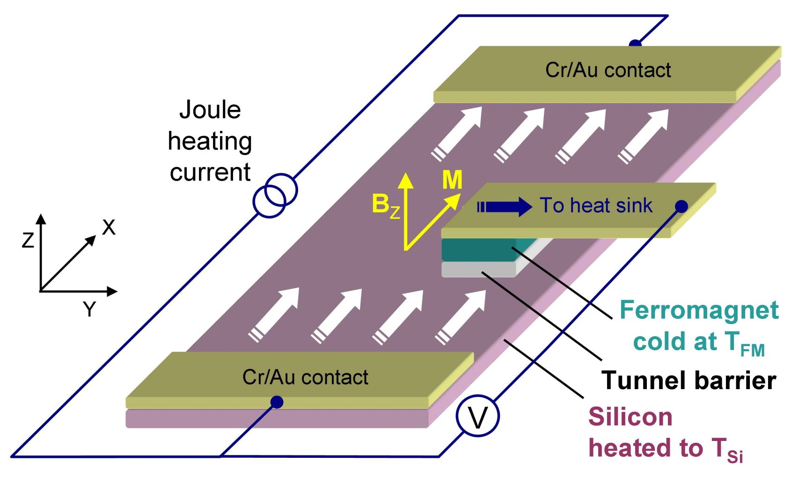
Thermal spin current from ferromagnet to Si
Joule heating of Si
p-type Si / Al₂O₃ / Ni₈₀Fe₂₀, T_{base} = 300 K, Si strip: 4000 x 800 x 3 μm³

Slide 34

Thermal spin current from ferromagnet to Si
Observation of Seebeck spin tunneling
Spin polarization induced by temperature difference only
No charge tunnel current
J.C. Le Breton et al.,
Nature 475, 82 (2011)

Slide 35
Thermally-induced spin accumulation in Si
Scaling with Joule heating power
p-type Si / Al₂O₃ / Ni₈₀Fe₂₀ T_{base} = 300 K
J.C. Le Breton et al., Nature 475, 82 (2011)

Slide 36
Anisotropy of the Seebeck coefficient
In-plane
Perpendicular
Anisotropy of S
J.C. Le Breton et al., Nature 475, 82 (2011), supplement
R. Jansen, Proc. SPIE 8813, 88130A (2013)

Slide 37
Origin of the thermal spin current

Slide 38
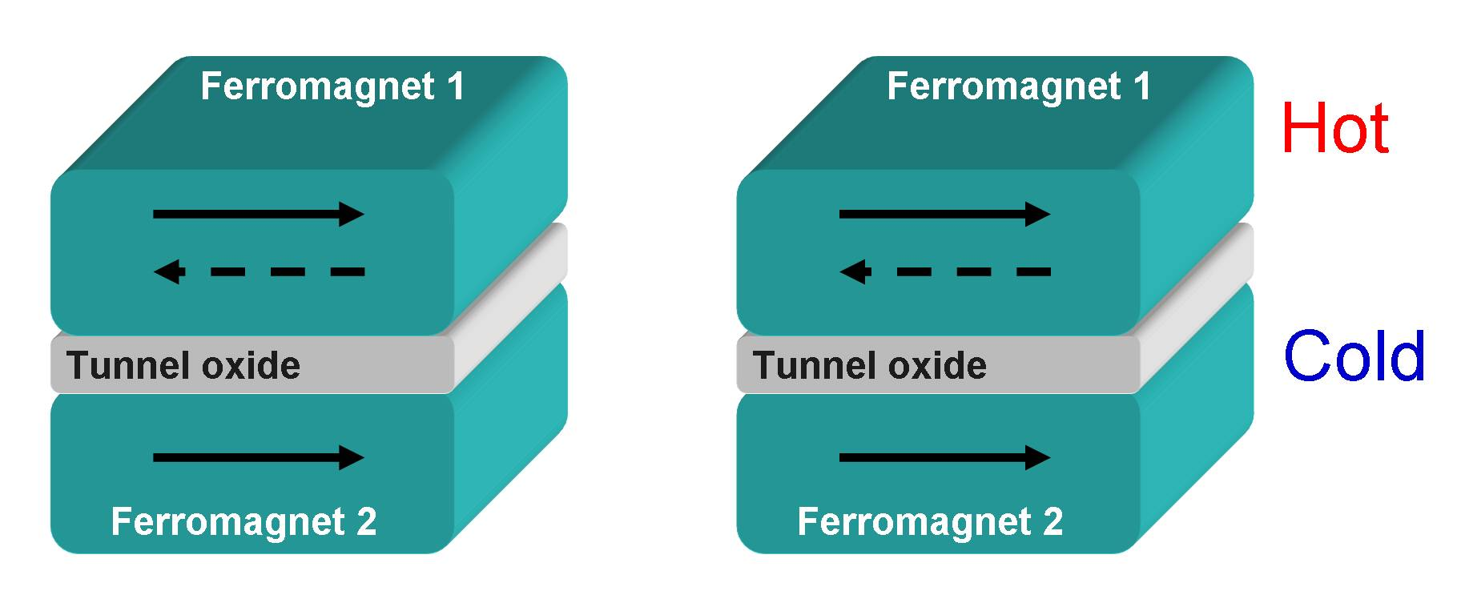
Spin-polarized tunneling
G↑ ≠ G↓
Tunnel conductance is spin dependent
(1971)
Tunnel magnetoresistance
at 300 K (1995)
Electrical spin injection
(1999 - ……)

Slide 39
Seebeck spin tunneling
S↑ ≠ S↓
Seebeck coefficient of tunnel contact is spin dependent
(Le Breton et al. 2011)
Thermal spin injection
(Le Breton et al. 2011)
Tunnel magneto-thermopower
(Walter et al. / Liebing et al. 2011)

Slide 40
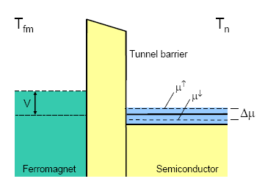
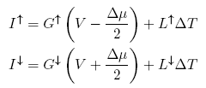
Electrical detection of Seebeck spin tunneling
Thermally-induced
spin accumulation
ΔV_{Hanle}
Charge
thermopower

Slide 41
Seebeck spin tunneling coefficient
spin resistance
of semiconductor
electrical thermal
Spin-dependent
Seebeck coefficient
Jansen, Deac et al.
PRB 85, 094401 (2012)

Slide 42
Charge Seebeck effect
governed by energy derivative of charge conductivity
E
σ
(E > E_{F})
E_{F}
σ
(E < E_{F})
T₁ T₂

Slide 43
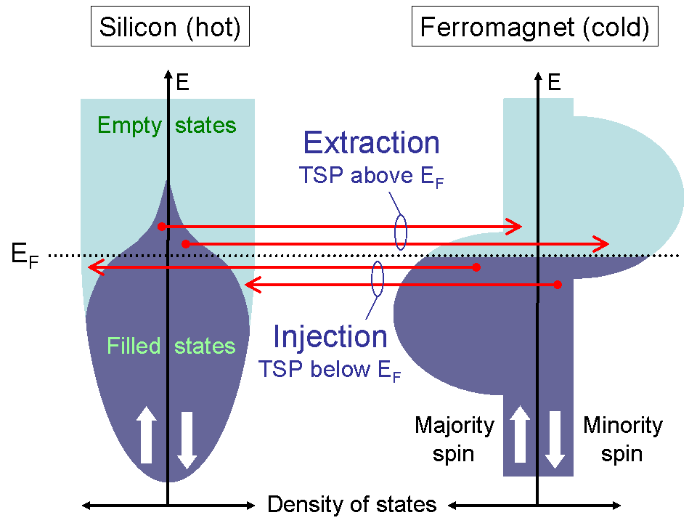
Seebeck spin tunneling (SST)
J.C. Le Breton et al., Nature 475, 82 (2011)

Slide 44
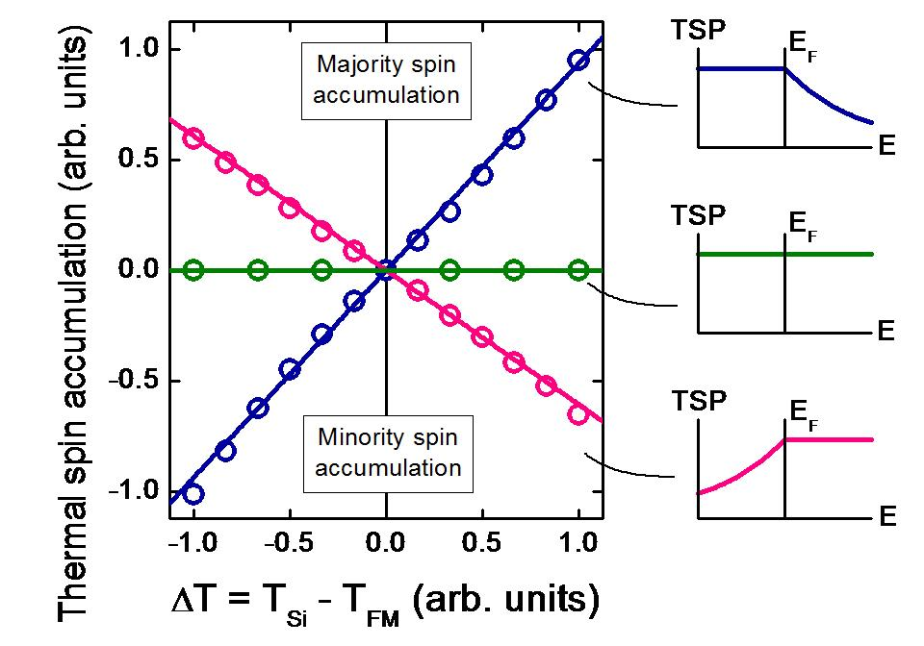
Seebeck spin tunneling
Governed by energy derivative of tunnel spin polarization

Slide 45
Sign of the thermal spin current

Slide 46
Control of the sign of the spin polarization
by direction of heat flow
J_{heat}
J_{heat}
“positive spin polarization”
“negative spin polarization”
Reversing the heat flow ⇒ Opposite spin polarization

Slide 47
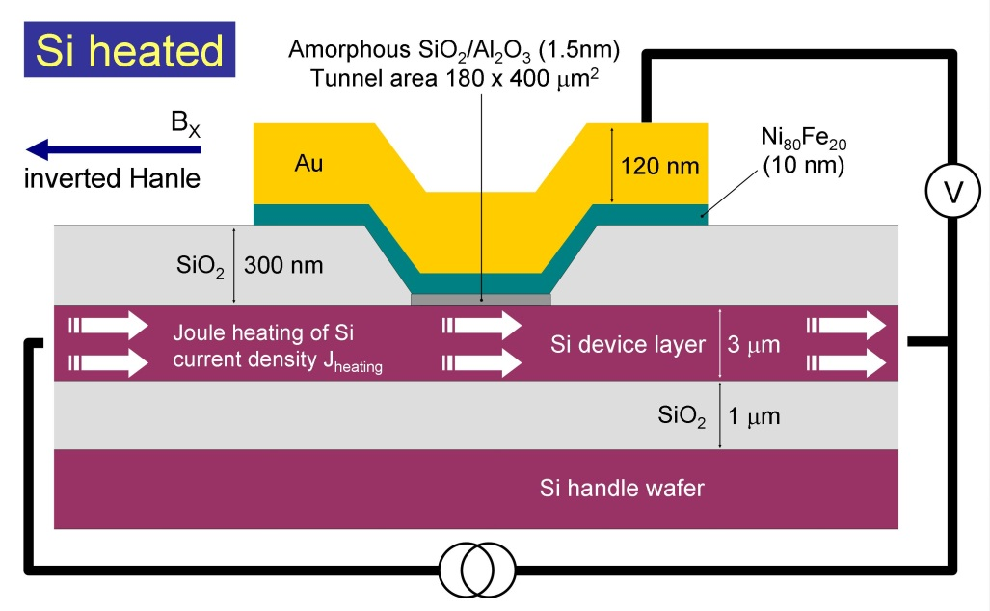
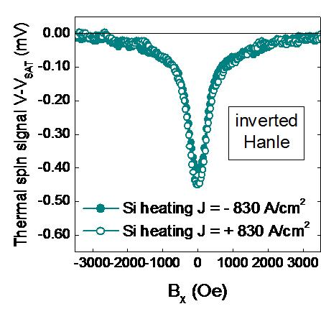
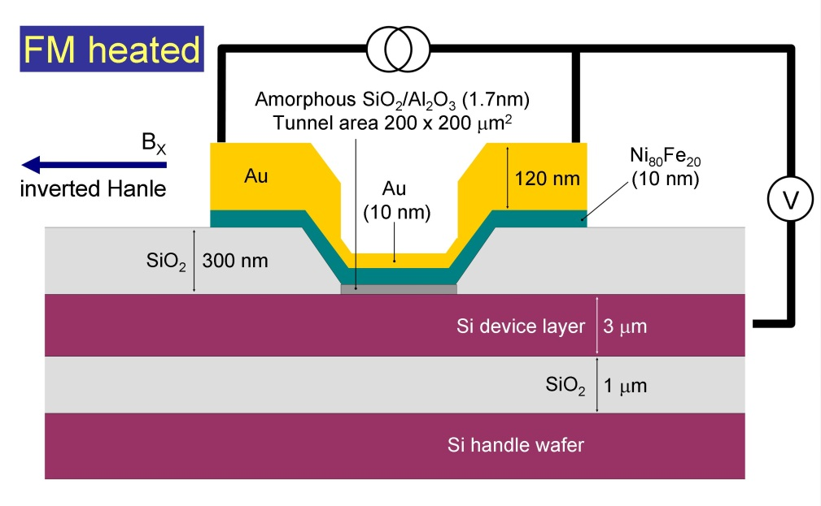
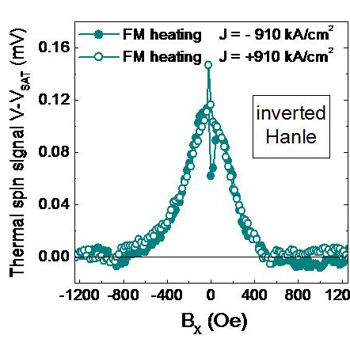
Sign reversal of thermal spin accumulation
Si heated
FM heated

Slide 48
Thermal + electrical spin currents
K.R. Jeon et al.
Nature Materials 13,
360 (2014)

Slide 49
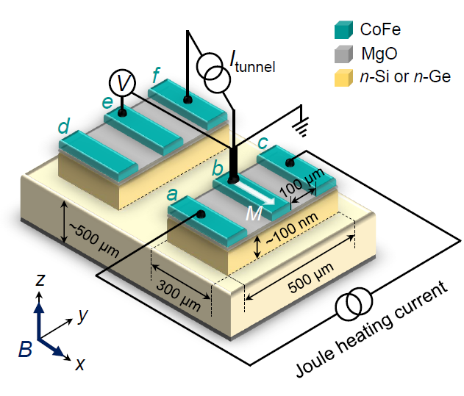
Simultaneous thermal & electrical driving force

Slide 50
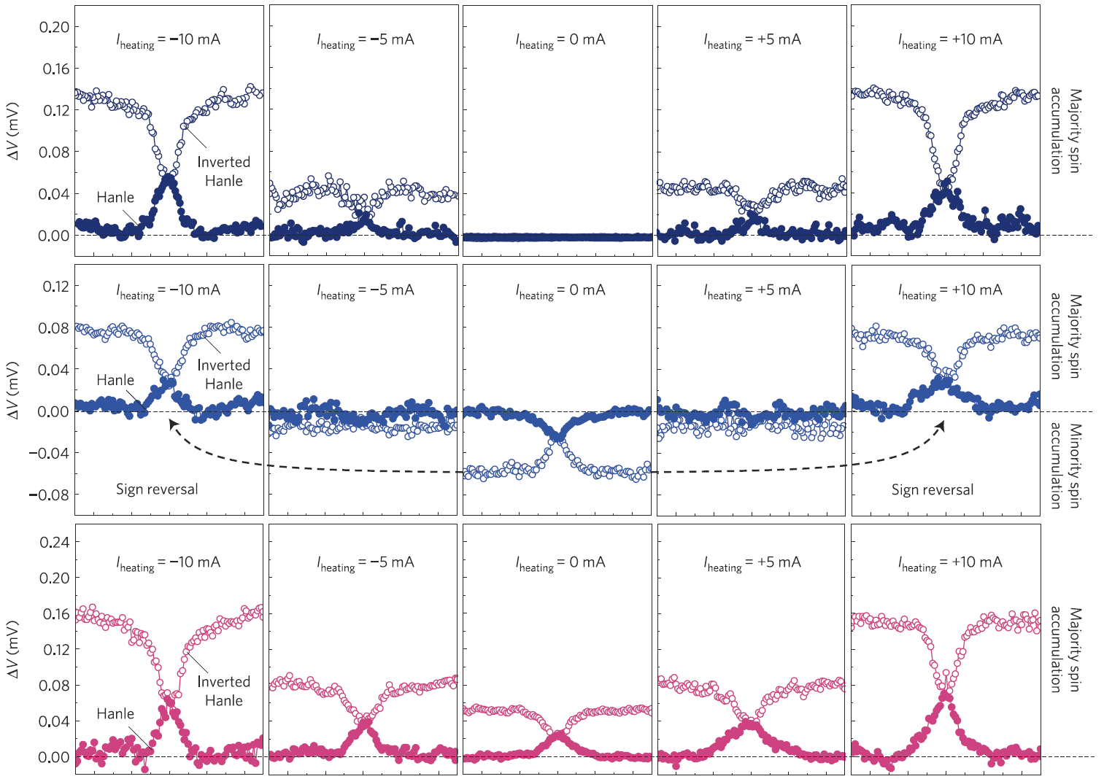
Thermal & electrical spin current together
Thermal
only
Thermal
+
electrical
spin
extraction
Thermal
+
electrical
spin
injection

Slide 51
Voltage tuning of the thermal spin current

Slide 52
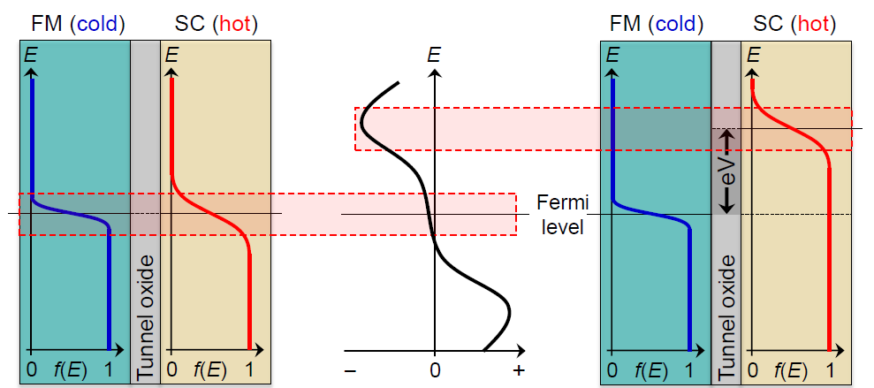
Spin thermoelectrics away from Fermi energy
Conventional thermal spin
current near Fermi energy
Thermal spin current
at finite bias voltage
∂P
∂E

Slide 53
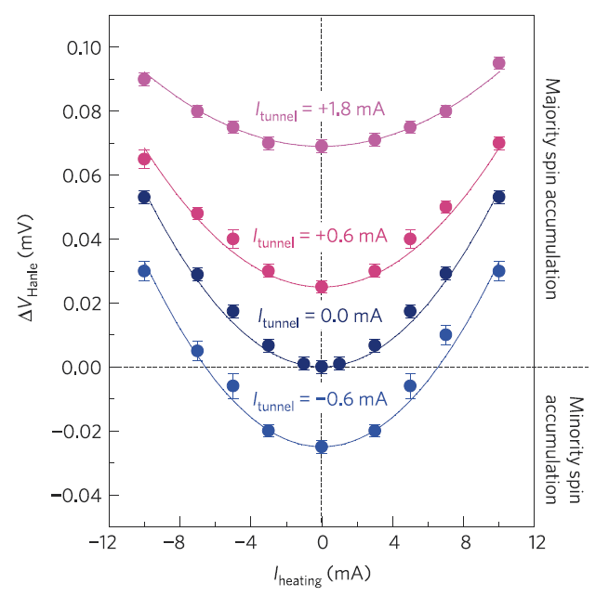
Tuning of thermal spin current with voltage
Thermal spin current
with positive bias
Thermal spin current
at zero bias
K.R. Jeon et al.
Nature Materials 13,
360 (2014)

Slide 54
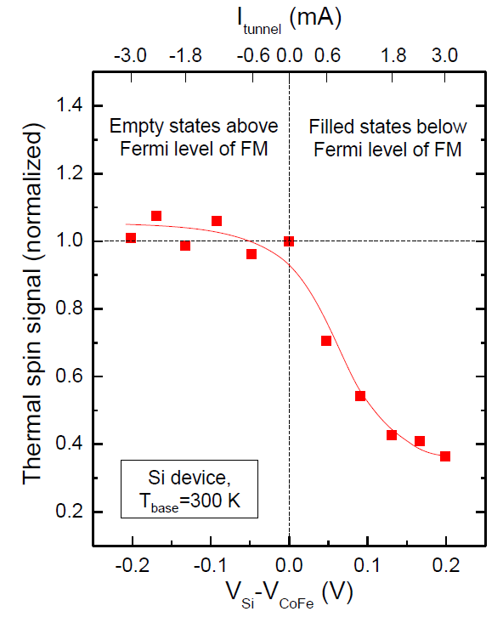
Voltage tuning of thermal spin current
Magnitude of thermal
spin current is tuned
by bias voltage
Tunneling states
with a different
∂P
∂E
n-type Si / MgO / Co₇₀Fe₃₀

Slide 55
Electrical creation & detection of spin
polarization in Si using magnetic tunnel contacts
Thermal spin current into Si without a charge tunnel current, by Seebeck spin tunneling
For recent reviews of silicon spintronics, see
R. Jansen, Nature Materials 11, 400 (2012)
R. Jansen et al. Semicon. Sci. Technol. 27, 083001 (2012).
Email: ron.jansen@aist.go.jp

